Slide 1



Math & life: how close are we to math
Kate & Annie

Slide 2
Combination
Useful Resources:
Khan Academy
YouTube
Helpful Links:
https://www.khanacademy.org/math/precalculus/x9e81a4f98389efdf:prob-comb/x9e81a4f98389efdf:combinations/v/introduction-to-combinations
https://www.khanacademy.org/math/precalculus/x9e81a4f98389efdf:prob-comb/x9e81a4f98389efdf:combinations/v/combination-formula

Slide 3
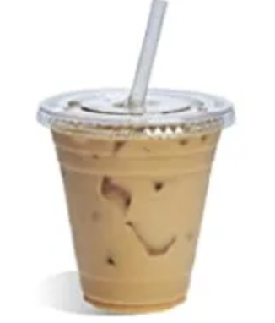
Review The Milk Tea Problem
  Price of 1 milk tea
Do you like drinking milk tea? Have you thought about why may the price of a cup of milk tea be raised?
Suppose the cost of the ingredients is ¥1.
100 cups are sold each day when the price is ¥5.
As the price is raised by ¥1, 5 cups are sold less.
How much would the milk tea store raise to earn the best profit?
  Cost
  Profit
# of cups sold:
  …
  Total Profit = Profit of 1 cup * # of cups sold

Slide 4

  Raise the price by x
  …
  Profit = original profit + raised money x = 4+x
  …
X = 1
# of cups sold = 95 = 100-5(1)
# of cups sold?
X = 2
# of cups sold = 90 = 100-5(2)
  …
X = 3
# of cups sold = 85 = 100-5(3)
X = x
# of cups sold = 100-5x
  Total Profit: Profit of 1 cup * # of cups sold
(4+x)
(100-5x)
= $−5x^{2}+80x+400$

Slide 5
Suppose you are a YouTuber, and the chart below shows the number of followers you have in the past 7 days. Is it possible to reach 1k followers at the end of this month (3weeks) if the number grows at a normal rate?
Videoes, Movies, and Music · $1000
 | Mon | Tues | Wed | Thur | Fri | Sat | Sun
# of people viewed your page | 100 | 103 | 124 | 115 | 236 | 106 | 129
Their Follow rate | 12% | 10% | 15% | 12% | 17% | 10% | 10%
# of followers at the end of the day (suppose no one unfollows) | 216 | 226 | 245 | 256 | 296 | 317 | 330
No☹

Slide 6
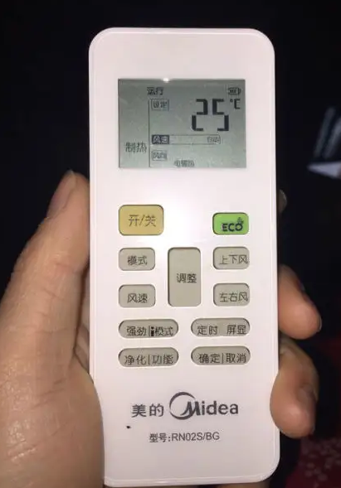
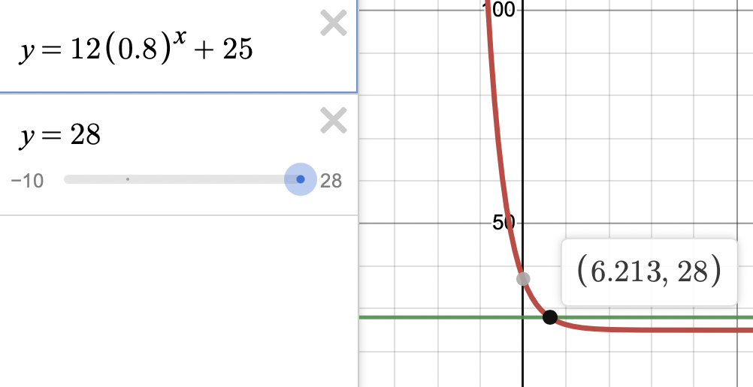



You found a dead body in a room. You tested his temp, “28 $°C$ .” The air conditioner remote control is shown below. Suppose the model equation for calculating temperature after t minutes is $T=12{\left(0.8\right)}^{t}+25.$How many minutes ago was the person shot? (use the calculator)
Logic and detectives · $800
It’s a random BONUS! Get double points with the correct answer!
$≈$6.2 min
$$T=12{\left(0.8\right)}^{t}+25$$
T = 28
X $≈$ 6.2

Slide 7
There are two islands, let’s call them Island A/B. People from Island A tell the truth, whereas people from Island B tell lies. One day, a traveler forgot whether she is on Island A or Island B, but she knew it once she asked a question to a random person on the island (suppose this person is either from island A or B). Do you know what question she asked?
Logic and detectives · $1000
“Are you from this island?”

Slide 8
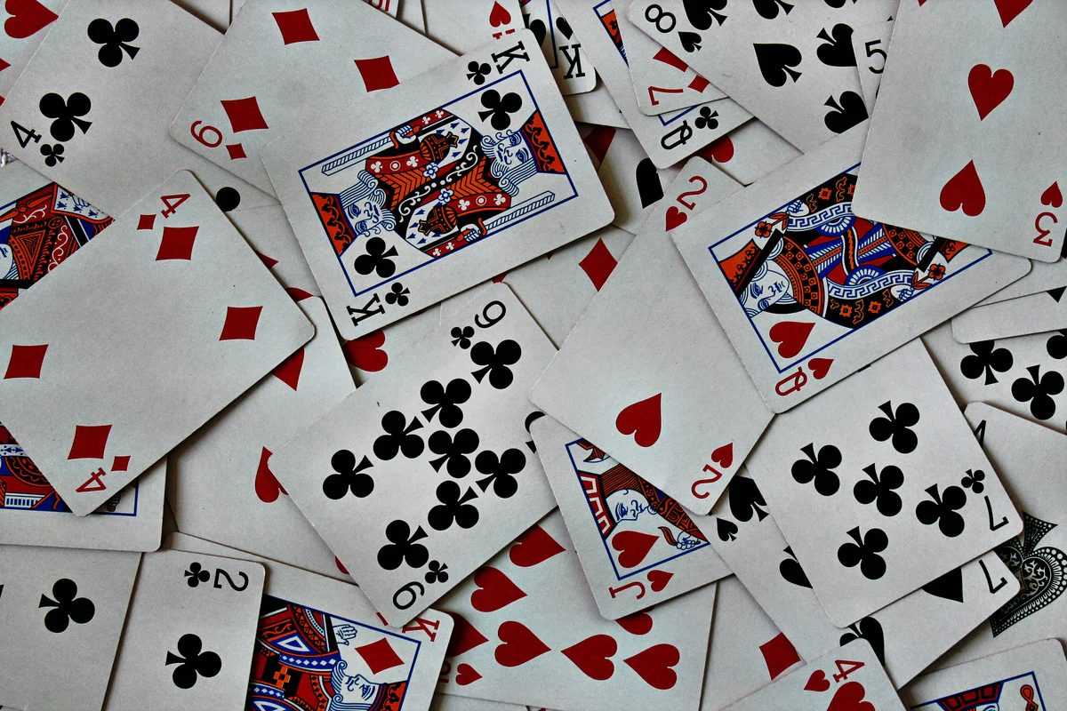
You are playing “Fight the Landlords” with your friends. What is the probability that your first 2 cards are the two jokers (suppose you draw the cards first)? (a deck has 54 cards)
Let’s play games · $800
1/1431
The first card is a jocker: 2/54
The second card is a jocker: 1/53
2/54 * 1/53 = 1/1431

Slide 9
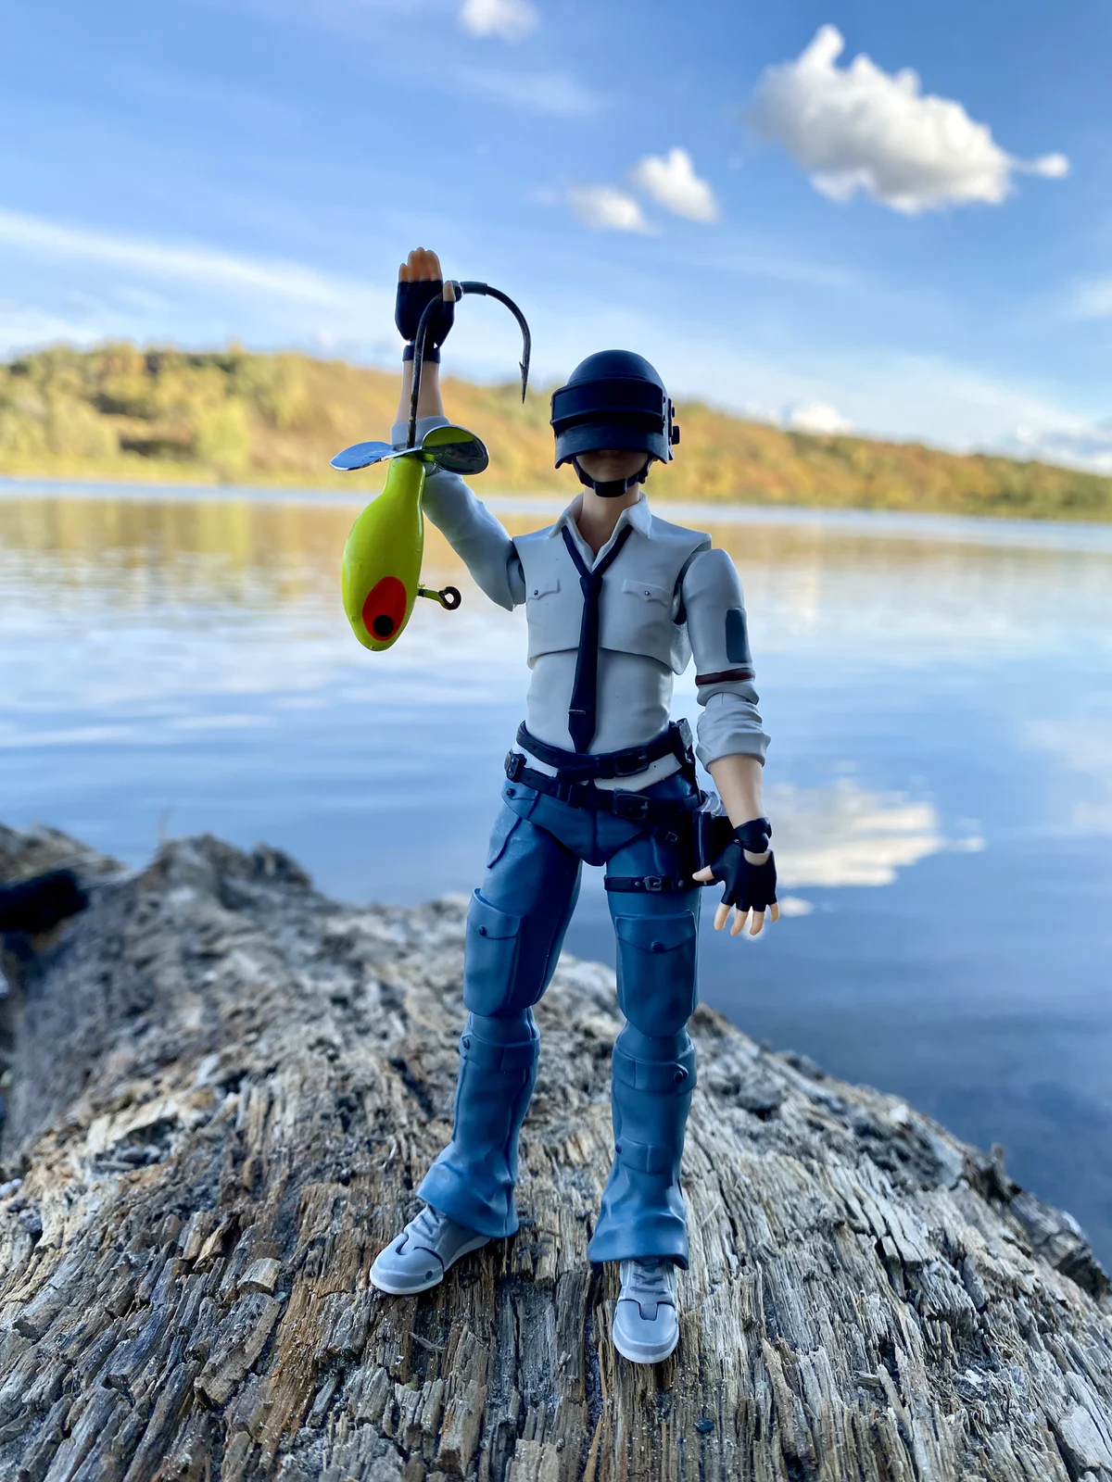
You and your friends are going to play PUBG and you guys are splitting into 3 teams. Suppose there are 7 boys and 5 girls. If the teams are grouped in random, what is the probability of 4 boys ending up in 1 team?
Let’s play games · $1000
7/33
3* (7C4) / (12C4)

Slide 10
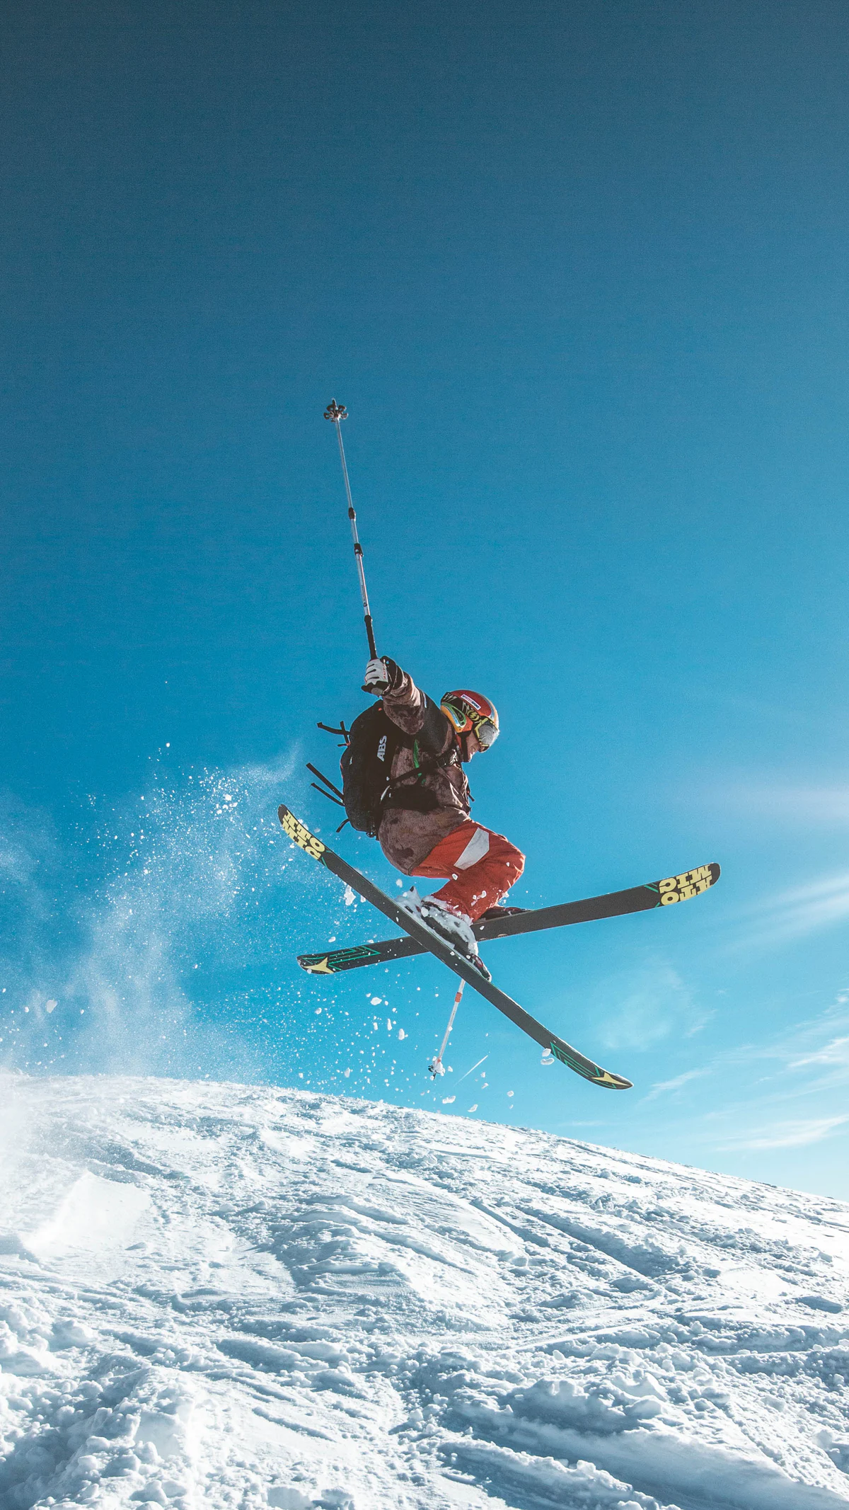
Assuming you live in Beijing, and you are traveling to Zhangjiakou for a skiing trip. The total distance between Beijing and Zhangjiakou is 194km. The car has been moving for 75 minutes at 80km/h, how long would it take you and your family to arrive in Zhangjiakou if the car speeds up to 94km/h?
Wanna travel together · $600
75min = 1.25 h
1.25 * 80 = 100 km
194 -100 = 94km
94/94 = 1 hour
1 hour

Slide 11
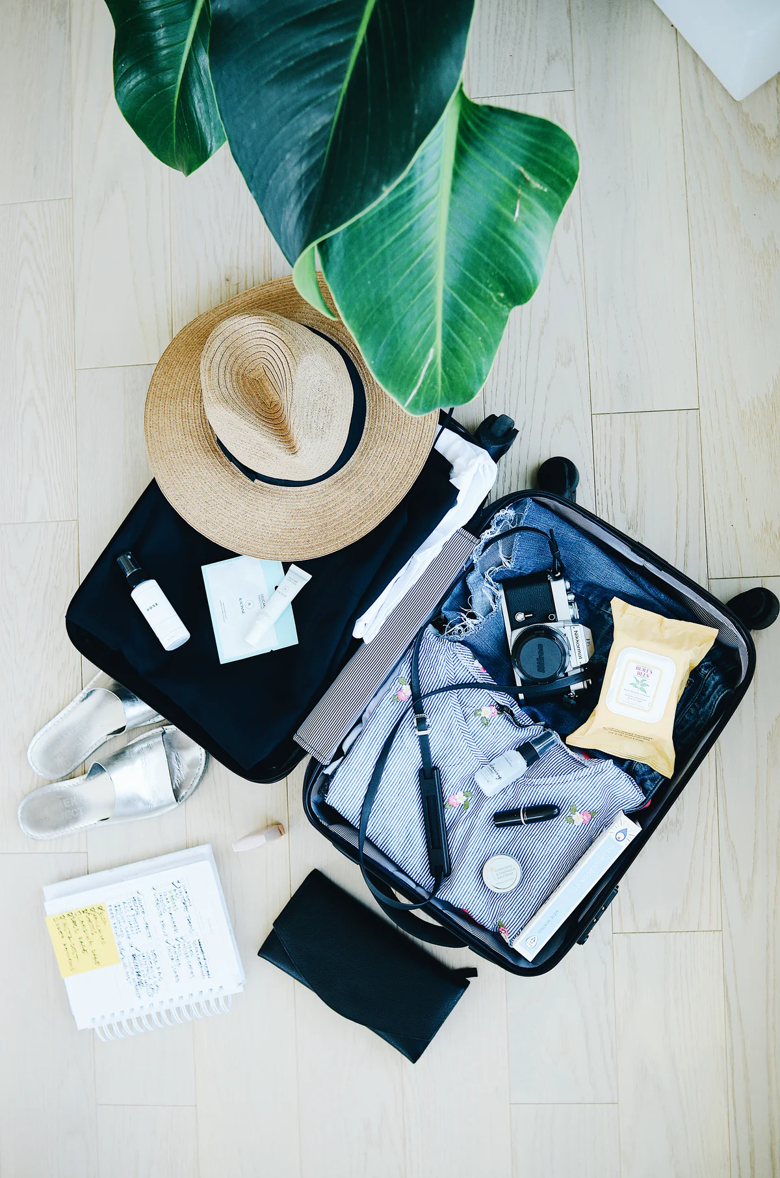

Suppose your suitcase is a rectangular box(0.5m*0.5m*0.25m). Can you fit in your tennis racket? A standard tennis racket is about 0.6858m.
Wanna travel together · $800
It’s a random BONUS! Get double points with the correct answer!
Yes!
$0.5\sqrt{2} ≈0.7$m
0.5
0.5

Slide 12
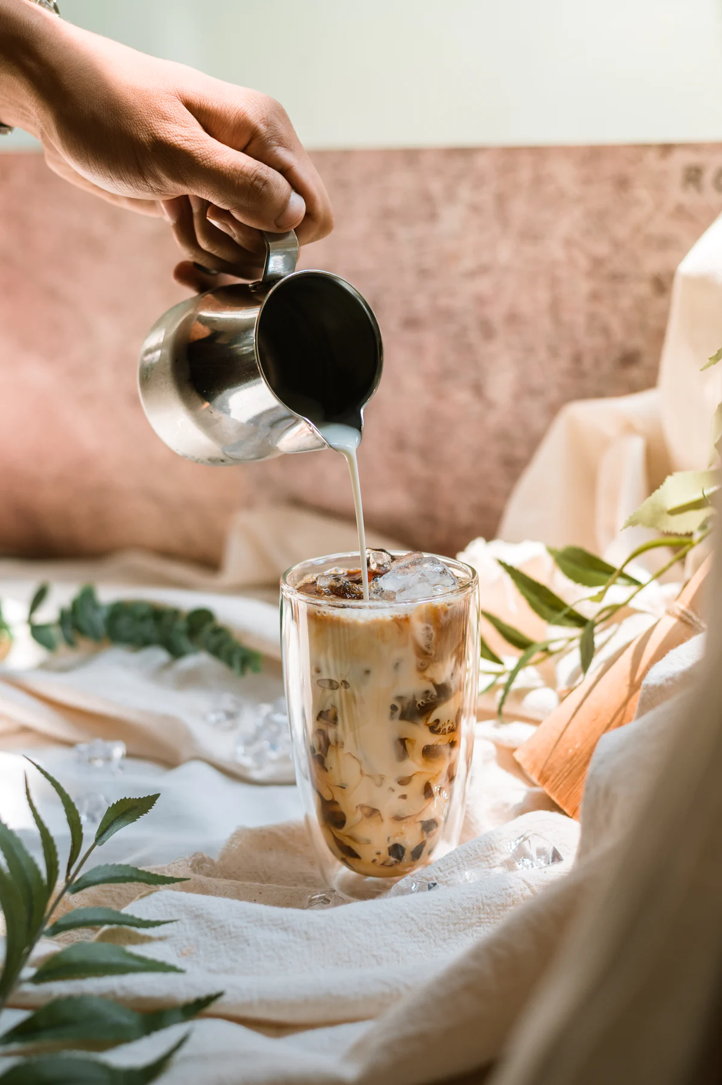

Do you like drinking milk tea? Have you thought about why may the price of a cup of milk tea be raised?
Suppose the cost of the ingredients is ¥1. 100 cups are sold each day when the price is ¥5. As the price is raised by ¥1, 5 cups are sold less. How much would the milk tea store raise to earn the best profit?
Food! Yumyum · $800
Cost = 1
Let x be the raised money in dollars
Profit = (5+x-1)(100-5x)
= (x+4)(100-5x)
= $−5x^{2}+80x+400$
Profit has the maximum value when x = -(80)/(2(-5))= ¥8
¥8

Slide 13
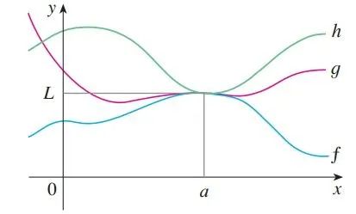
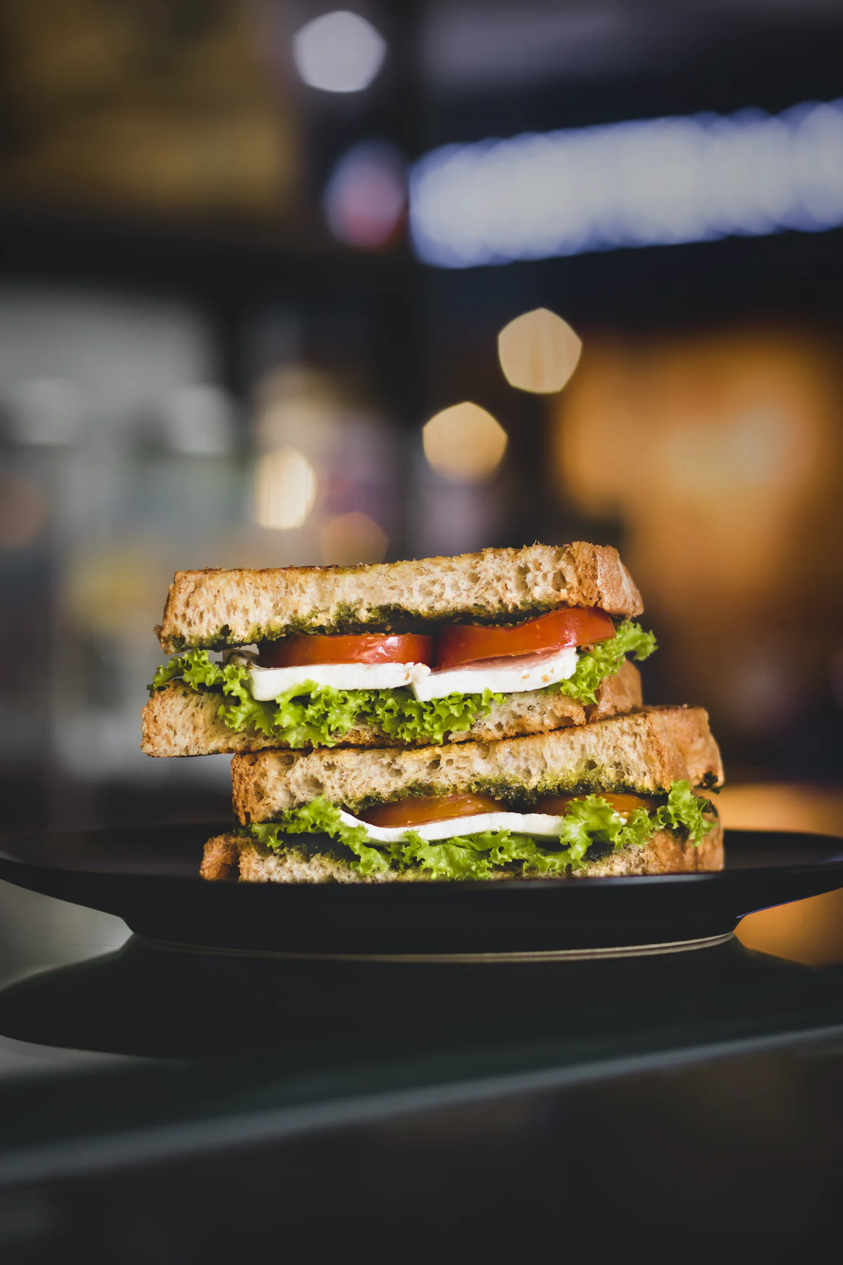
（Congrats! No math question here but yes POINTS!)
Do you know that there is a math theorem called Sandwich Theorem? It is a theorem in Calculus which helps us know the limit of a function. Don’t know what’s a limit? No worries, you will learn it in high school~
Food! Yumyum · $1000

Slide 14
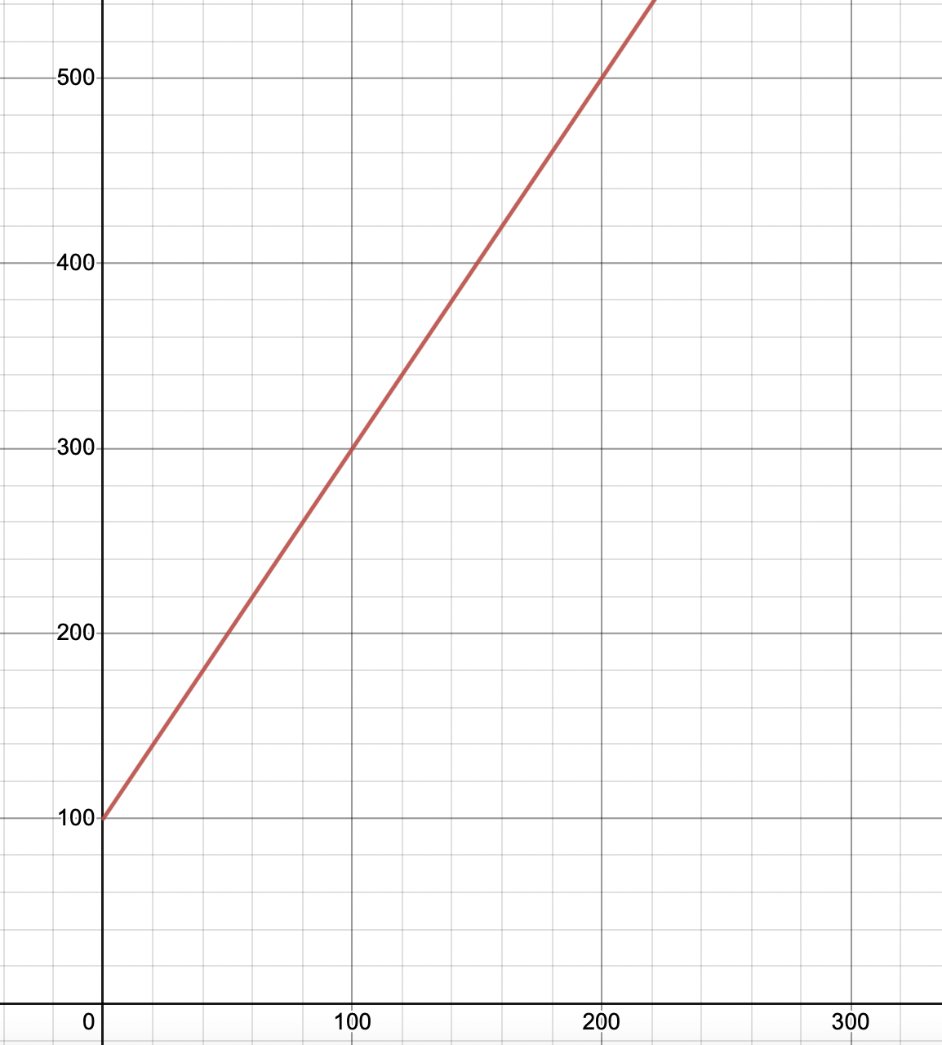
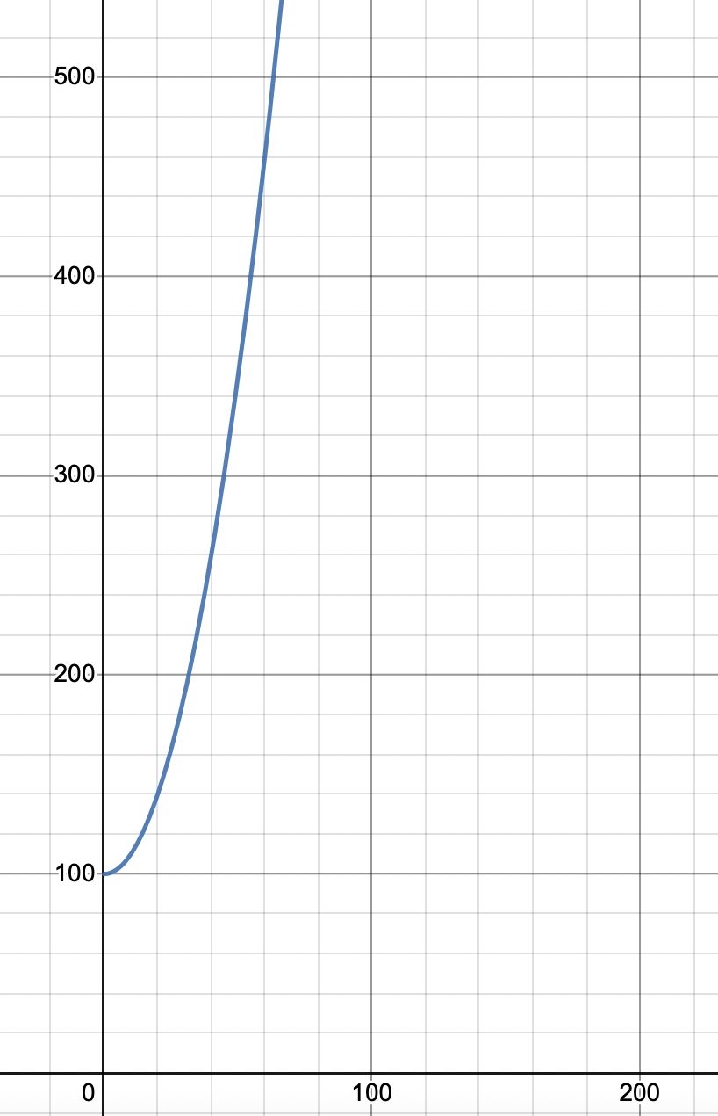
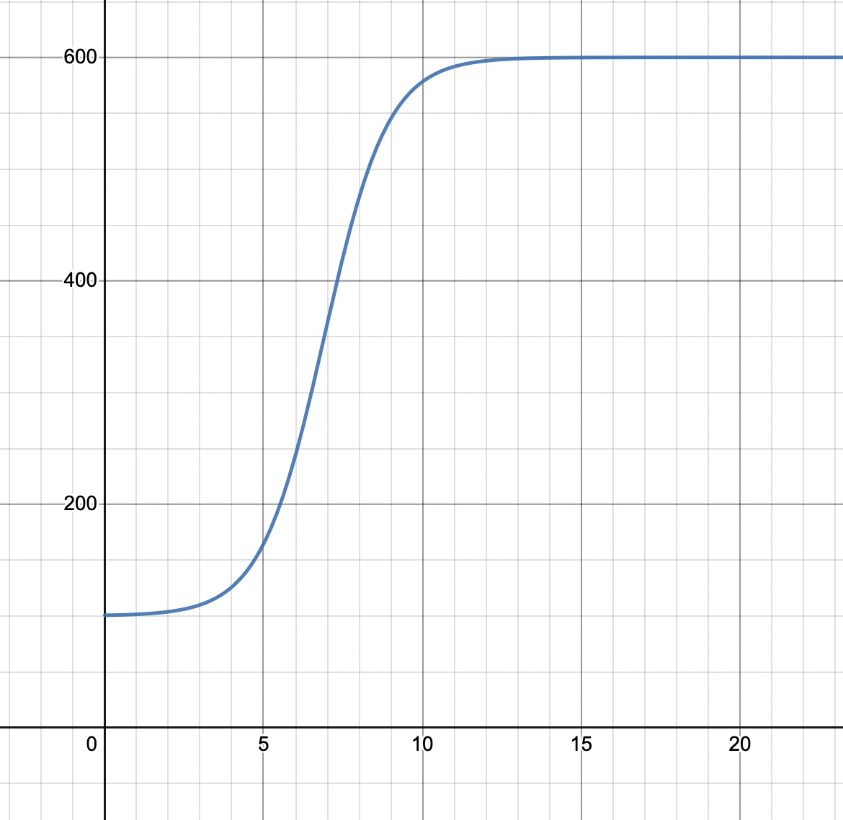
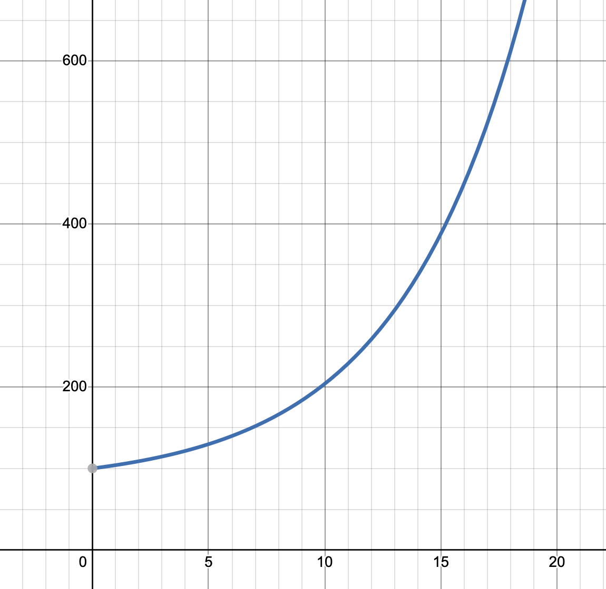
Which of the following graph might best model the population growth of deers in a certain area?
Animath · $800
A
B
C
D

