Slide 1
Forces and Energy
The Niagara Falls, on the USA-Canada Border. The photograph shows the highest section of the falls, where the water crumbles over 50 meters to the river below. Nearly three million litres of water flow over the falls every second. Most of the energy is wasted, but some is harnessed by a hydroelectric power station which generates electricity for the surrounding area.

Slide 2
Work
In everyday languages work might be writing an essay or digging the garden.
But to scientists and engineers, work has a precise meaning: work is done whenever a force makes something move.
The greater the force and the greater the distance moved, the more work is done.
The SI unit of work is the joule (J):
1 joule of work is done when a force of 1 newton (N) moves an object 1 meter in the direction of the force.
Work is calculated using this equation:
work done = force * distance moved in the direction of the force
In symbols: W = F * d
For example, if a 4 N force moves an object 3 m, the work done is 12 J.

Slide 3
Energy
Things have energy if they can be used to do work.
Like work, energy is measured in joules (J).
Although people talk about energy being stored or given out, energy isn’t a “thing”.
If, say, a compressed spring stores 100 joules of energy, this is just a measurement of how much work can be done by the spring.
Moving objects have energy. e.g. a moving ball
Materials are made up of atoms which are constantly in motion. A material has more energy when hot than when cold.

Slide 4
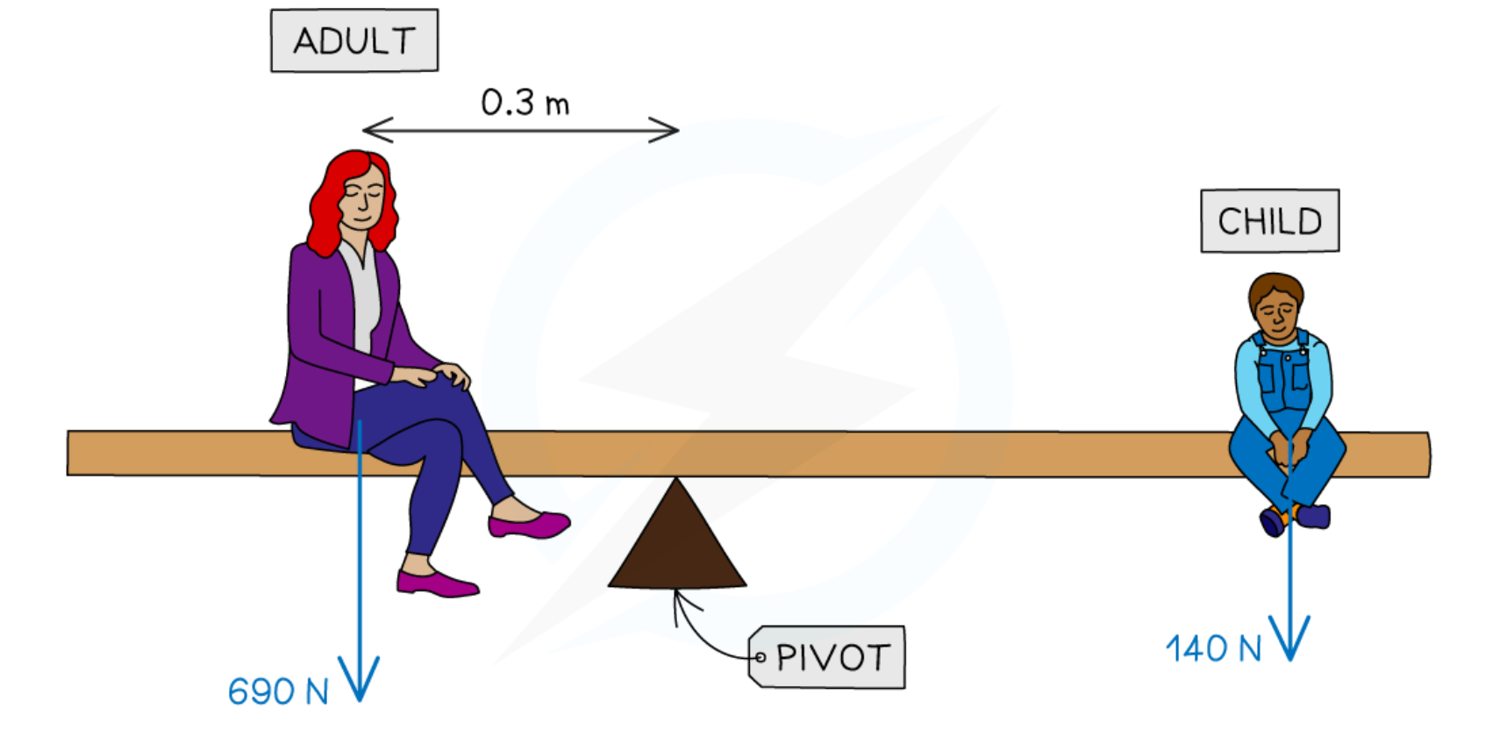
Forms of energy
Kinetic energy: This is energy due to motion. All moving objects have kinetic energy.
Potential energy: This is energy which an object has because of its changed position, shape or state. There are several different types of potential energy. Here are some of the terms used to describe them:
Gravitational potential energy
Elastic potential energy
Chemical potential energy
Electrical potential energy
Nuclear potential energy
Thermal energy: When hot objects cool down, their atoms and molecules slow down and lose energy. This is known as thermal energy, or heat.
Radiated energy: The Sun radiates light. Loudspeakers radiate sound. Light and sound both travel in the form of waves. These carry energy.

Slide 5
Typical energy values
Gravitational potential energy of a skier at the top of a ski jump
Kinetic energy of a car travelling at 70 mph (30 m/s)
Chemical energy in a chocolate biscuit
Chemical energy in one liter of petrol
Electrical energy supplied by a fully charged car battery
Kinetic energy of a football when kicked
Chemical energy in all the food you eat in one day
Thermal energy needed to boil a kettle full of water
a. 15 000 J
b. 300 000 J
c. 50 J
d. 35 000 000 J
e. 500 000 J
f. 2 000 000 J
g. 11 000 000 J
h. 700 000 J

Slide 6
Conservation of energy
To do work, you have to spend energy.
Like money, energy doesn’t vanish when you spend it.
It just changes into different forms.
When energy changes from one form to another, scientists say energy is transformed.
During each transformation, the total amount of energy stays the same. This is an example of the law of conservation of energy:
Energy cannot be made or destroyed, but it can change from one form to another

Slide 7
Calculating PE and KE
The ball below has potential energy because of the Earth’s gravitational pull on it and its position above the ground. This is called gravitational potential energy (PE). If the ball falls, it gains kinetic energy (KE). Both PE and KE can be calculated.

Slide 8
Calculating PE
The gravitational potential energy of the ball is equal to the work which would be done if the ball were to fall to the ground.
Assuming no air resistance, it is also equal to the work done in lifting the ball a distance h up from the ground in the first place:
Downward force on ball = weight of ball = mg
So: upward force needed to lift ball = mg
So: work done in lifting ball = force * distance moved = mgh
For an object of mass m at a vertical height h above the ground:
Gravitational potential energy = mgh

Slide 9
Calculating KE
The kinetic energy of the ball is equal to the work which the ball could do by losing all of its speed.
Assuming no air resistance, it is also equal to the work done on the ball in increasing its speed from zero to v in the first place:
work done = force * distance moved
work done = mass * acceleration * distance moved
work done = mass * (gain in speed / time taken) * (average speed * time taken)
work done = mass * gain in speed * average speed
W = m * v * 1/2 v
W = 1/2 mv^2
For an object of mass m and speed v:
kinetic energy = 1/2 mv^2

Slide 10
Practice
PE = mgh
KE = 1/2 mv^2
Assume that g is 10 N/kg and that air resistance and other frictional forces are negligible.
An object has a mass of 6 kg. What is its gravitational potential energy when it is
4 m above the ground
2. An object of mass 6 kg has a speed of 5 m/s.
What is its kinetic energy?
What is its kinetic energy if its speed is doubled?
3. A ball of mass 0.5 kg has 100 J of kinetic energy. What is the speed of the ball?

Slide 11
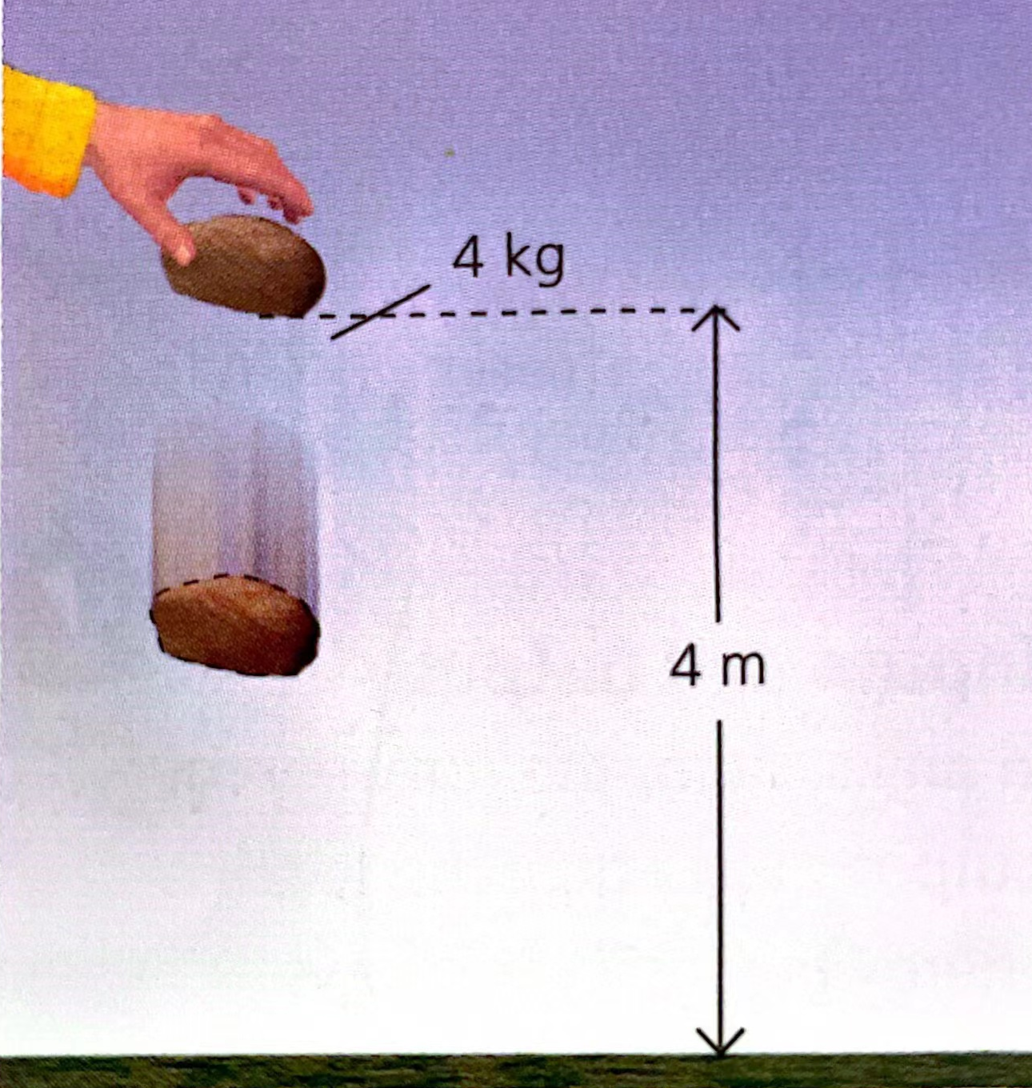
Example
PE = mgh
KE = 1/2 mv^2
If the stone on the right is dropped, what is its kinetic energy when it has fallen half-way to the ground? (G = 10 N/kg)
In problem like this, you don’t necessarily have to use KE = 1/2 mv^2. When stone falls, its gain in KE is equal to its loss in PE, so you can calculate that instead:
height lost by stone = 2 m
So: gravitational PE lost by stone = mgh = 4 kg * 10 N/kg * 2 m = 80 J
So: KE gained by stone = 80 J
As the stone started with no KE, this I the stone’s KE half-way done.

Slide 12
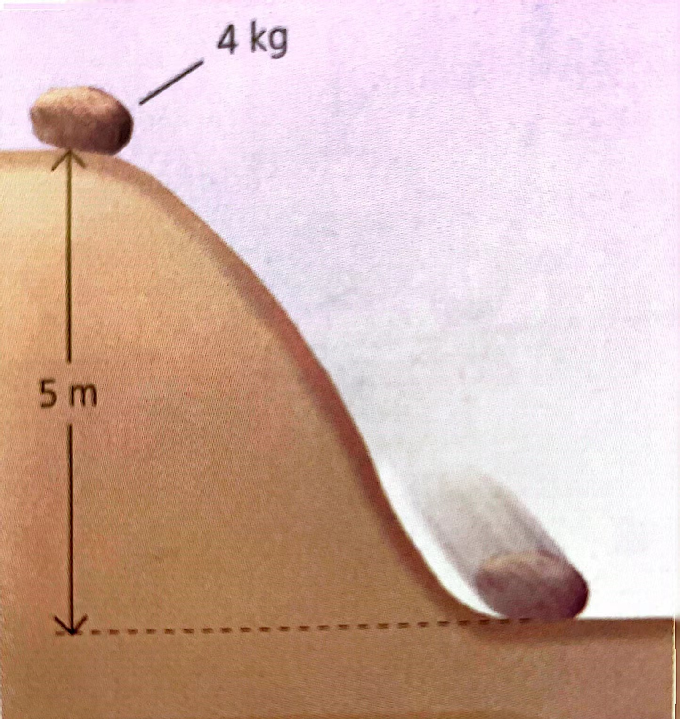
Example
PE = mgh
KE = 1/2 mv^2
The stone on the right slides down a smooth slope. What is its speed when it reaches the bottom? (g = 10 N/kg)
This problem can also be solved by considering energy changes. At the top of the slope, the stone has extra gravitational PE. When it reaches the bottom, all of this PE has been transformed into KE
Gravitational PE at top of slope = mgh = 4 kg * 10 N/kg * 5 m = 200J
So: kinetic energy at bottom of slope = 200J
So: 1/2 mv^2 = 200J
So: 1/2 * 4 kg * v^2 = 200J
V = 10 m/s
The stone’s speed at the bottom of the slope is 10 m/s.

Slide 13
PE = mgh
KE = 1/2 mv^2
Practice
A ball has a mass of 0.5 kg. Dropped from a cliff top, the ball hits the sea below at a speed of 10 m/s.
What is the kinetic energy of the ball as it is about to hit the sea?
What was the ball’s gravitational potential energy before it was dropped?
From what height was the ball dropped?

