Slide 1



Intro to Excel
Lesson 2

Slide 2




Level 1: Type to calculate
  Type the equal symbol (=) in a cell. This tells Excel that you are entering a formula, not just numbers.
  Type the equation you want to calculate. For example, to add up 5 and 7, you type =5+7
  Press the Enter key to complete your calculation. Done!
Lets Started

Slide 3

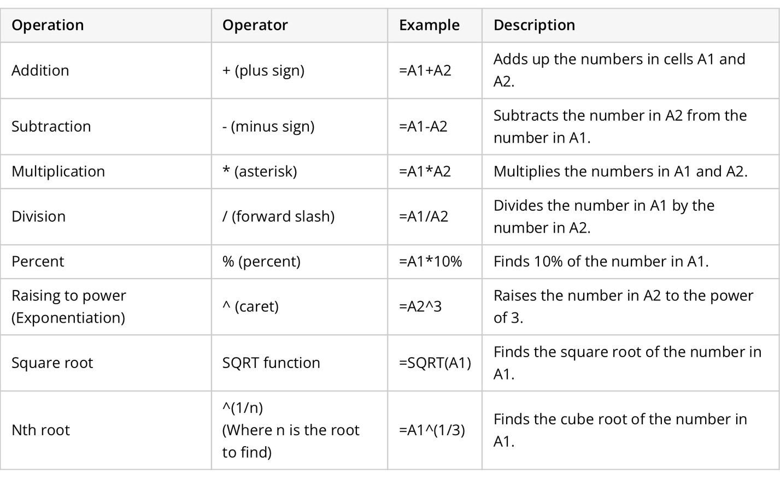
Level 1.5: Basic Calculations
Tips:
Instead of entering numbers directly in your calculation formula, you can put them in separate cells, and then reference those cells in your formula, e.g. =A1+A2+A3

Slide 4
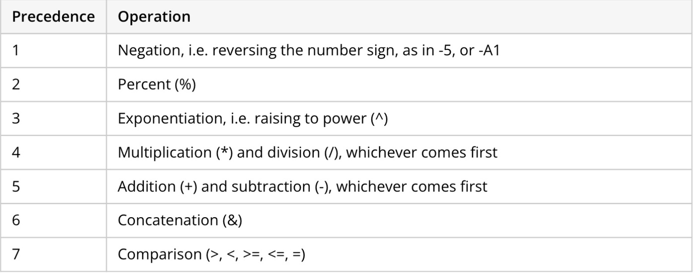

The order in which Excel calculations are performed

Slide 5

How to change the order of calculation?
  enclosing the part to be calculated first in parentheses.
=2*4+7 ➡️ =2*(4+7）
  Another example is finding a root in Excel.
=SQRT(16)，or an exponent of 1/2: =16^(1/2)

Slide 6

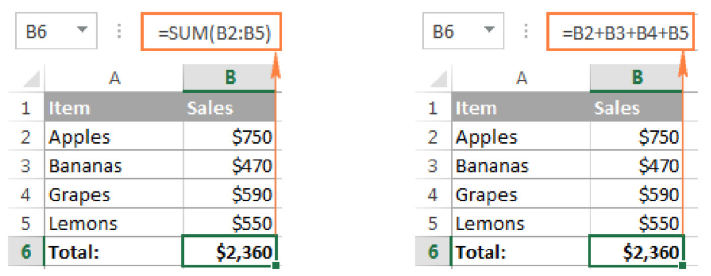

Level 2: Formulas
  All Excel formulas begin with an equal sign (=).
  After the equal symbol, you enter either a calculation or function. For example, to add up values in cells B1 through B5, you can either:
    Type the entire equation: =B1+B2+B3+B4+B5
    Use the SUM function: =SUM(B1:B5)
  Press the Enter key to complete the formula. Done!

Slide 7


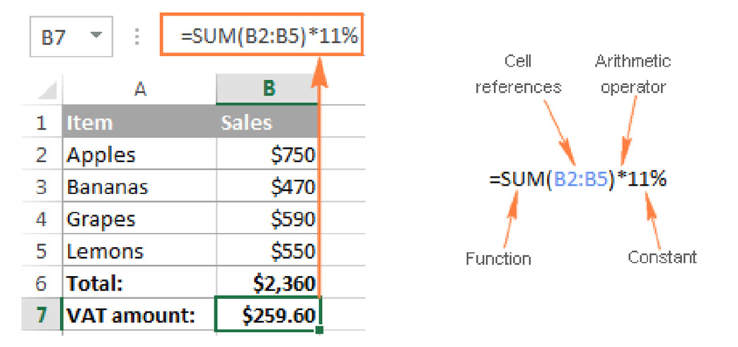

Elements of Excel Formulas
Names
(of other spreadsheet/doc)
Constant
Cell References
Functions
Operators

Slide 8


What are the operators??
—to tell excel what type of operation you want to perform in a formula.
1
2
  Arithmetic, e.g. ^, *, /, %
  basic mathematical operations such as addition, subtraction, multiplication, and division.
  Comparison/Logical
  =,<, >
  Always a « True » or « False » result
3
4
  Reference Operator
  Colon (:) - range operator , range=between two cells
  entire column (A:A) or entire row (1:1)
  Comma (,) - separate arguments
  e.g:=IF(A1>0; "good"; "bad")
  Text concatenation operator
  the ampersand symbol (&)
  Join two or more text strings in a single string.
  A1&A2

Slide 9

Practice Time!!

Slide 10


Basic Calculations

Slide 11
Exercise 1: Wavelength and Energy
Say that we are doing a physics experiment that is measuring how many energy each wavelength of light can produce. Here’s the task:
  given the formulas, can you calculate the energy using excel formulas?
  Can you make a chart that can visualize the relationship between wavelengh and energy in excel?
  WHat result can you get from your data?
  Formulas:
  Energy(J)=h*c/(wavelength*10^-9)
  1 (J)=6.25*10^18 (eV)

Slide 12

Exercise 2: Speed Gas Molecules
  We are doing another experiment, and we measured the temperature of a molecule. Now we have to calculate the velocity and get the kinetic energy that this molecule can produce under different temperature. The tasks for you are:
  can you convert the temperature into degree K?
  Can you apply formulas to calculate the velocity and kinetic energy?
  Can you make the correct chart?
  Formulas:
  Temperature C = 5/9 *(Temperature F-32)
  T(K)=T(C) + 273.15
  velocity (m/s) =SQRT((3*k*T(K))/calc Mass)
  1 m/s = 2.24 mph
  Kinetic Energy = 3/2 * k * temperature (K)

